Slide 1
ThoTh Lab
Gandu, Sri Sai Anusha (16230560)
Malineni, Anusha (16233382)

Slide 2
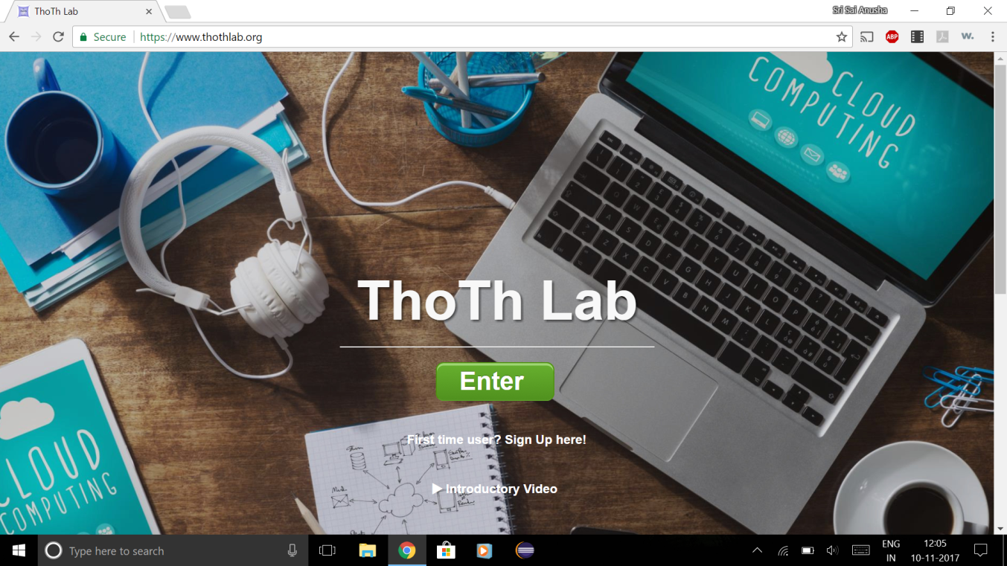
Introduction

Slide 3
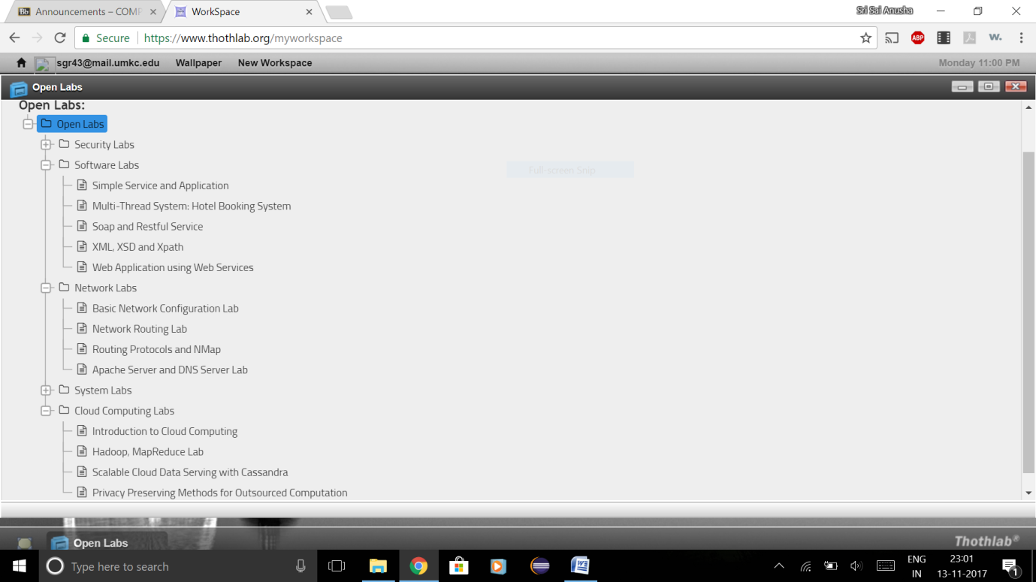
Open Labs

Slide 4
Cloud Computing Labs
Introduction to Cloud Computing
Hadoop, MapReduce Lab
Scalable Cloud Data Serving with Cassandra

Slide 5
Introduction to Cloud Computing
Shared pool to computing resources
Connected remotely
Minimal management effort

Slide 6
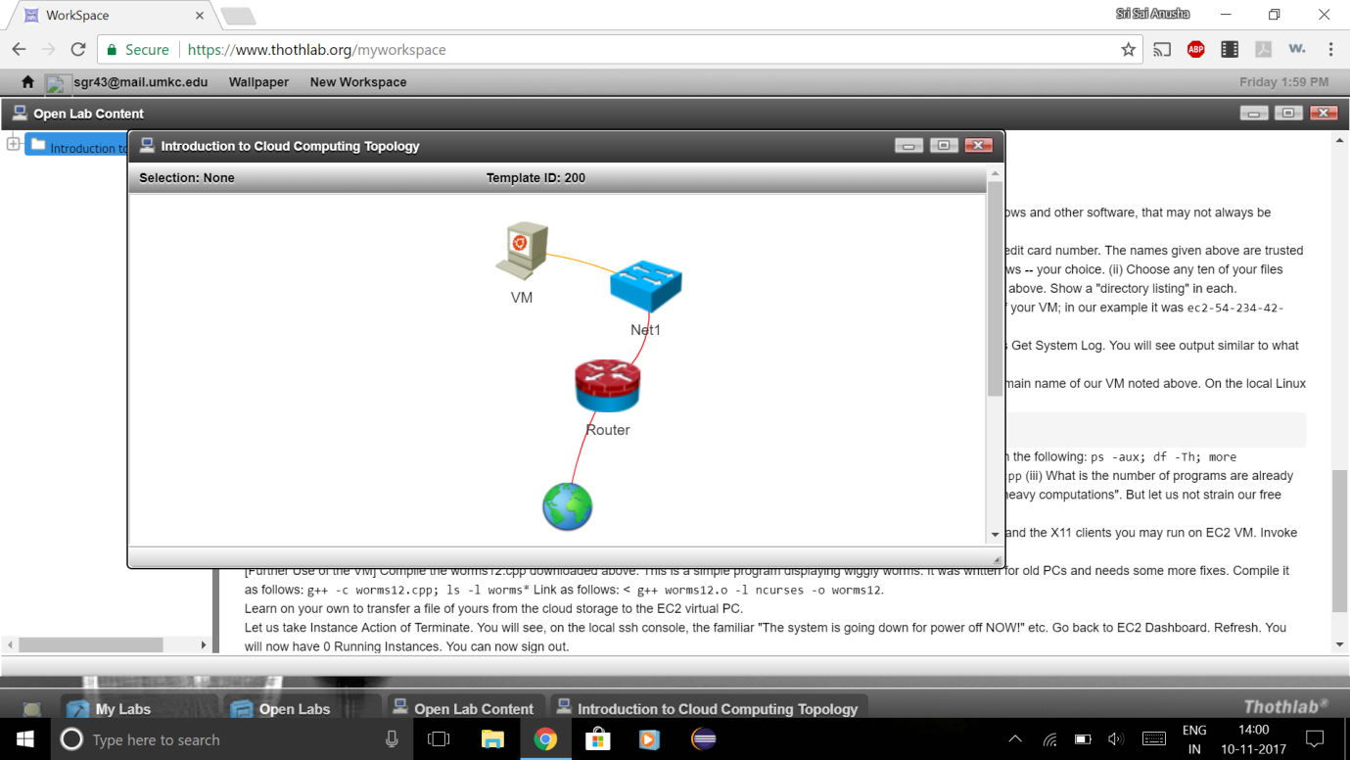

Slide 7
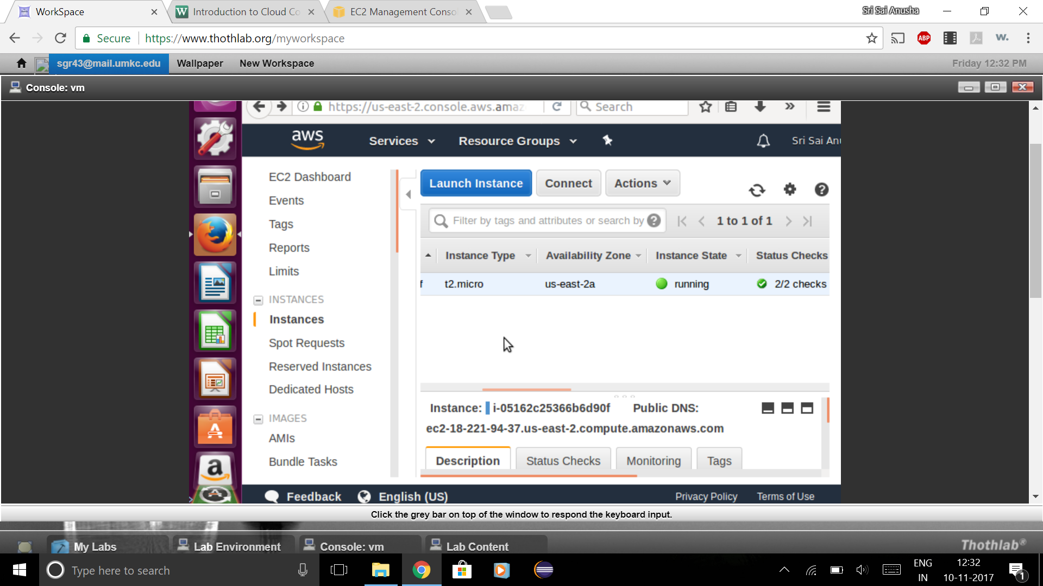

Slide 8
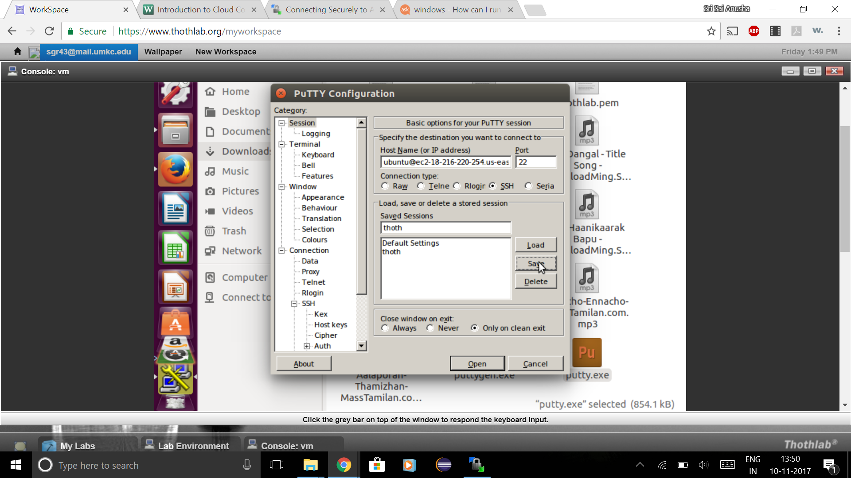

Slide 9
Hadoop, MapReduce Lab
Hadoop
Storage and Processing of large datasets
MapReduce
Programming model
Map step
Reduce step

Slide 10
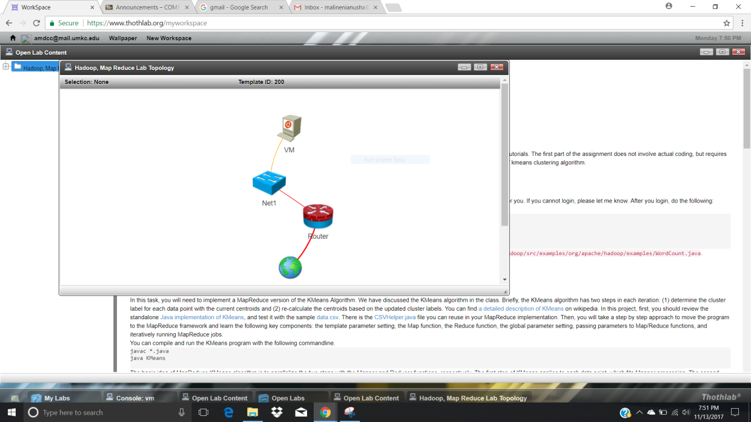

Slide 11
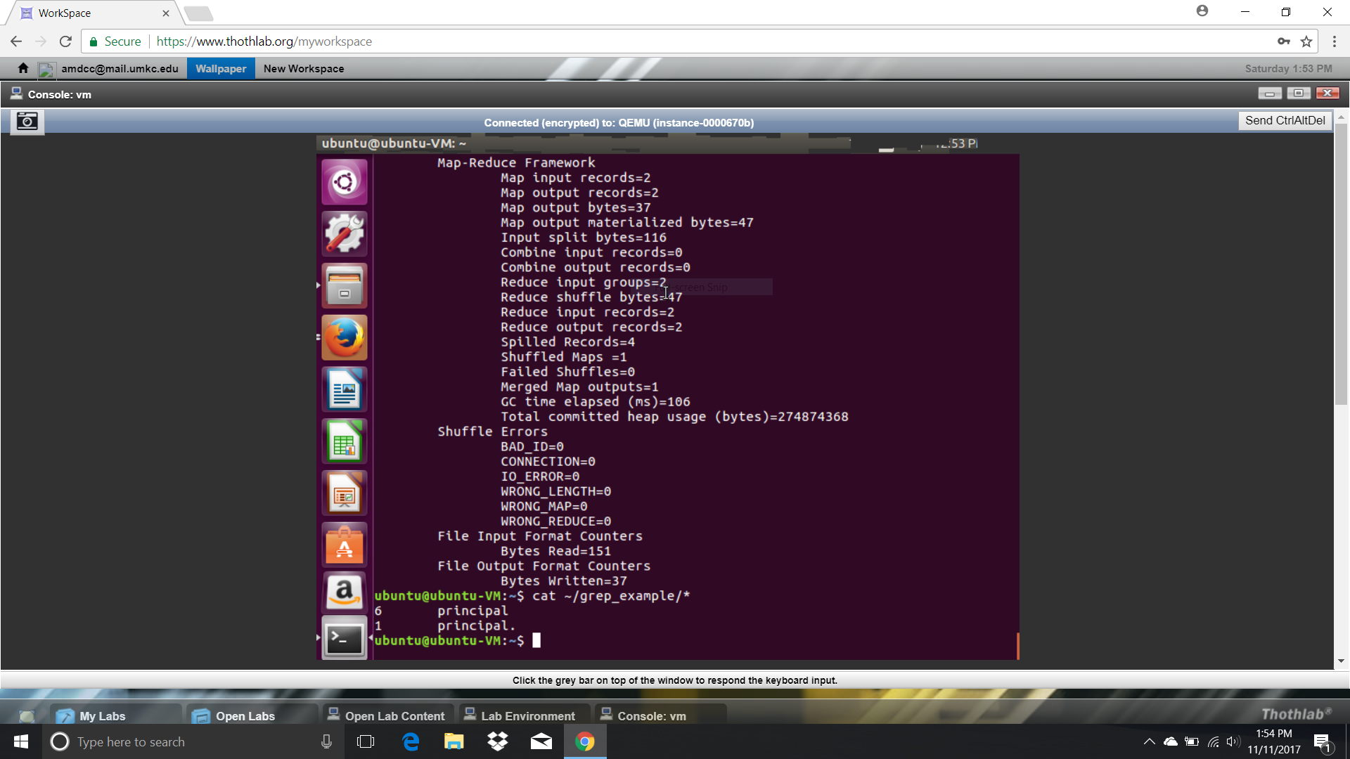

Slide 12
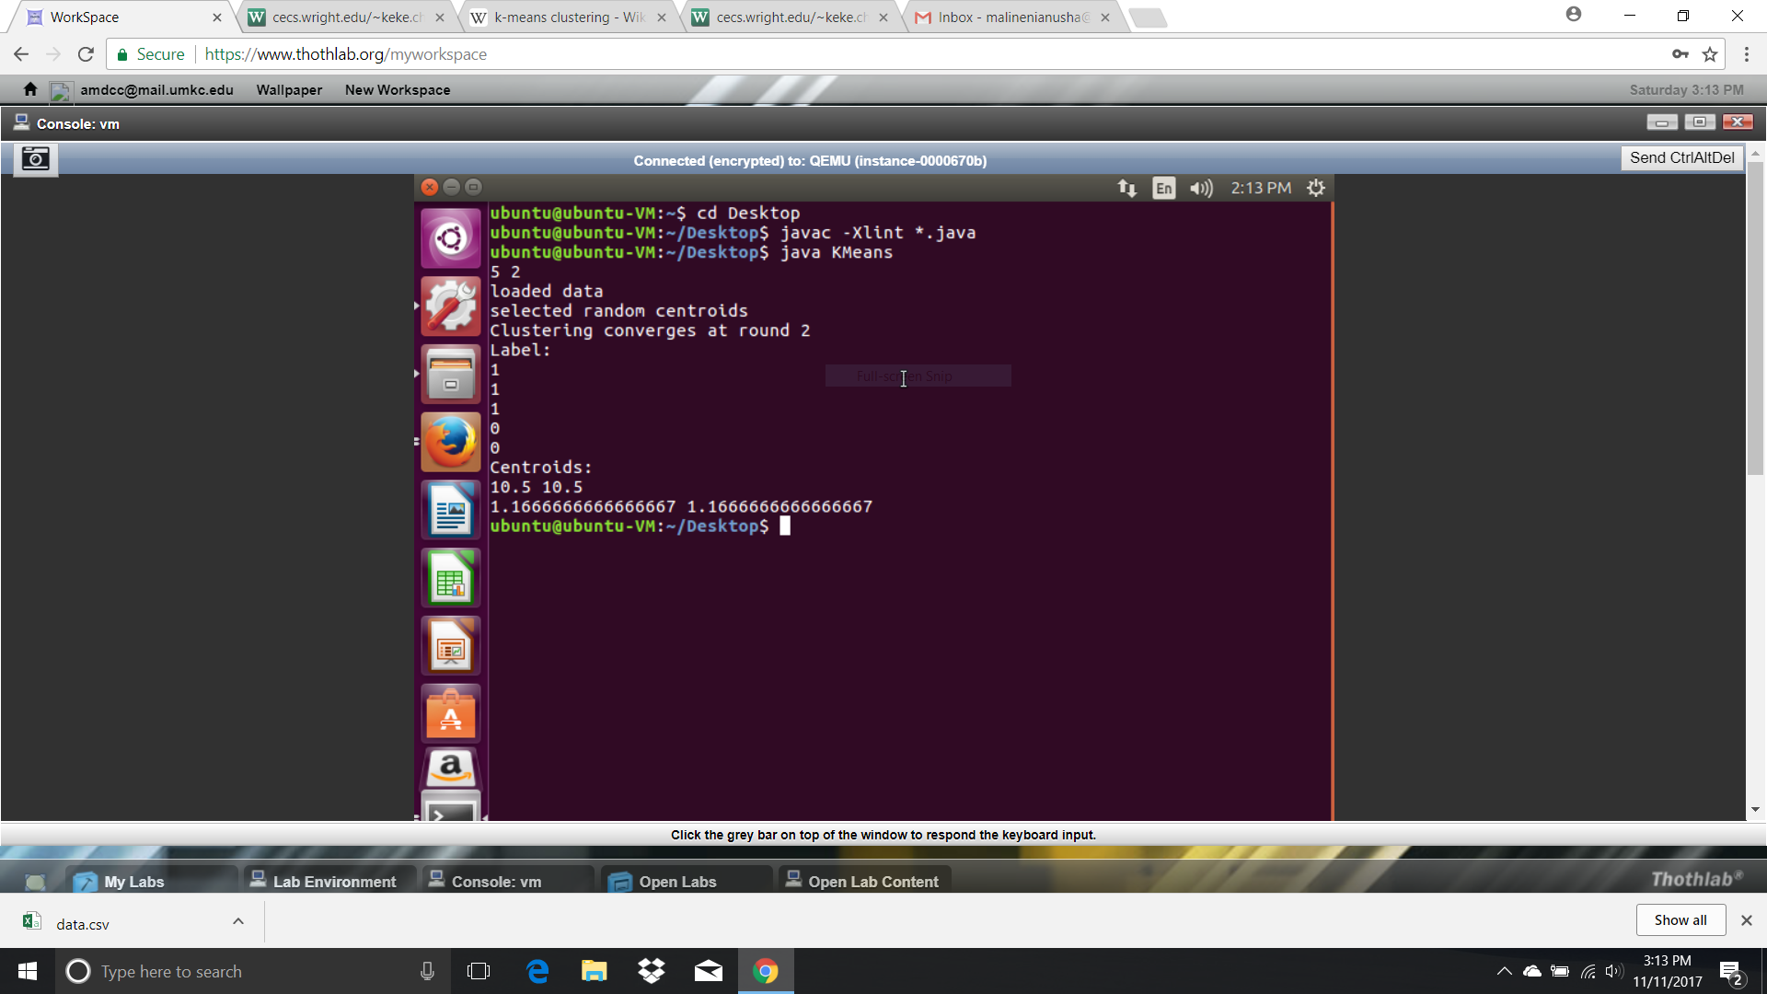

Slide 13
Scalable Cloud Data Serving with Cassandra
NoSQL database management system
Decentralized
Scalable

Slide 14
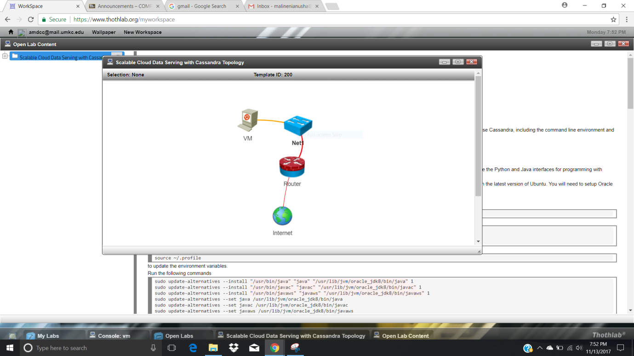

Slide 15
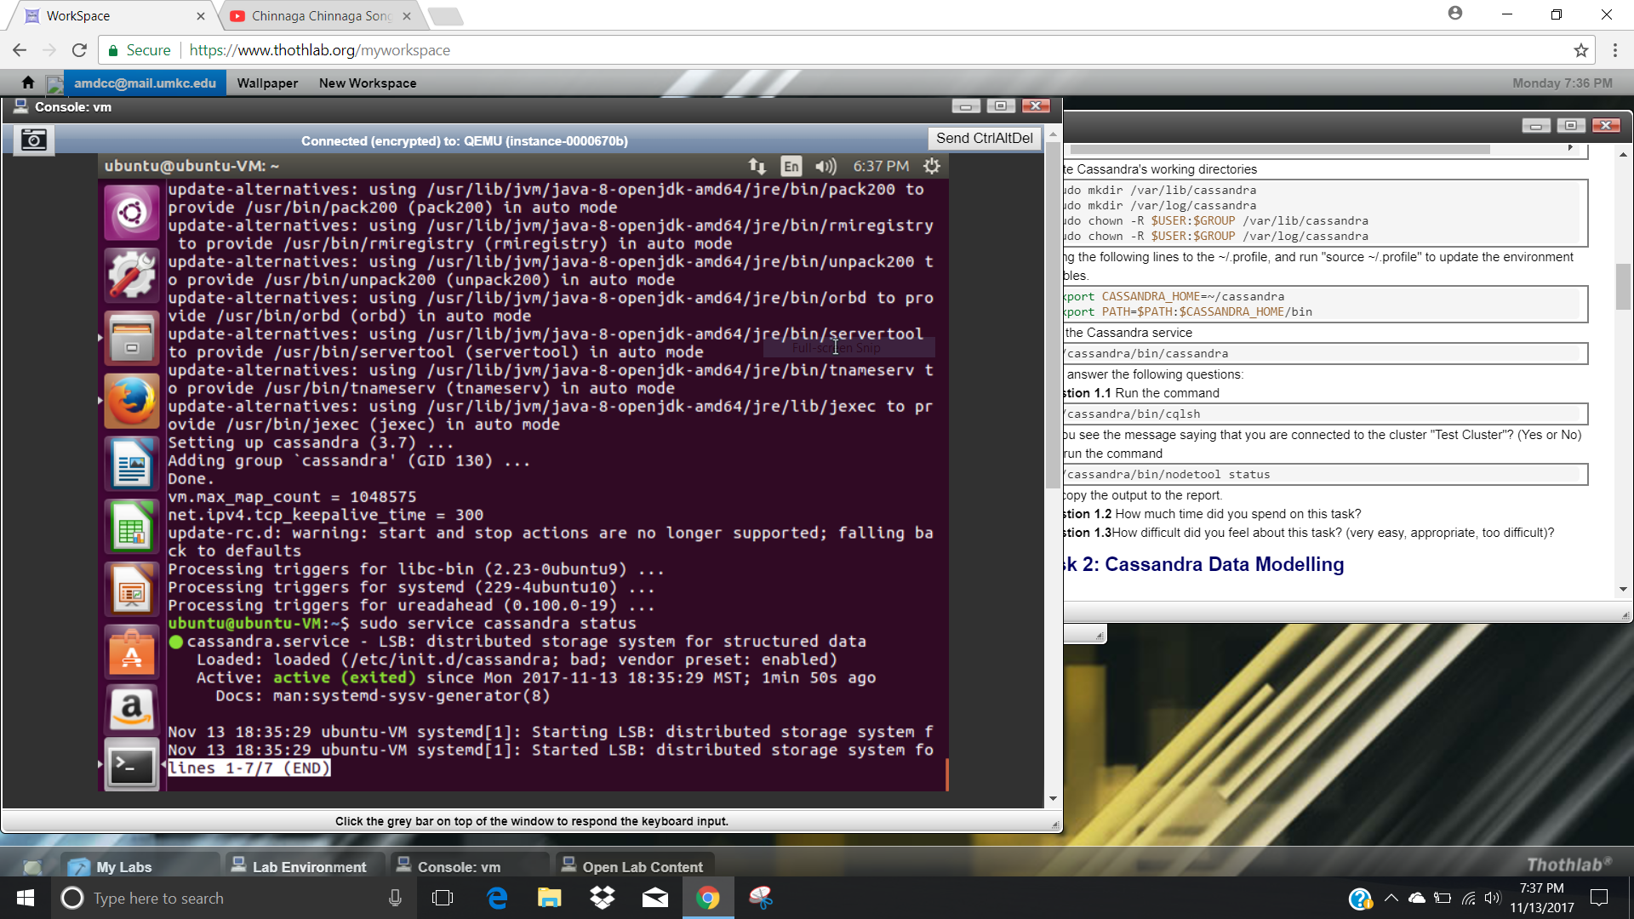

Slide 16
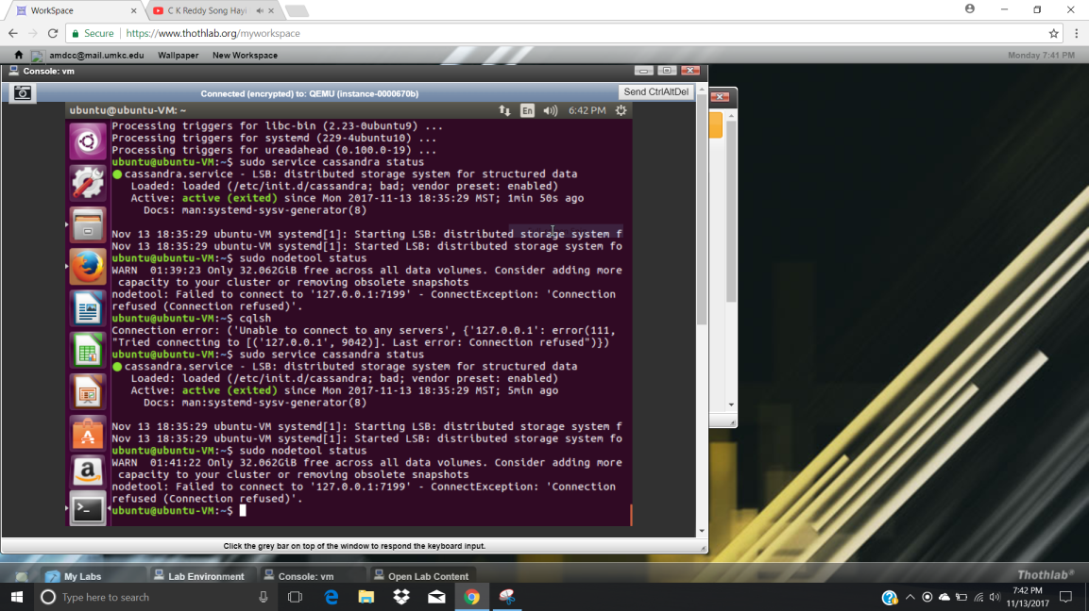

Slide 17
Network Labs
Basic Network Configuration Lab
Network Routing Lab
Routing Protocols and NMap
Apache Server Lab

Slide 18
Basic Network Configuration Lab
Address Resolution Protocol
Network Statistics
Shell Scripting

Slide 19
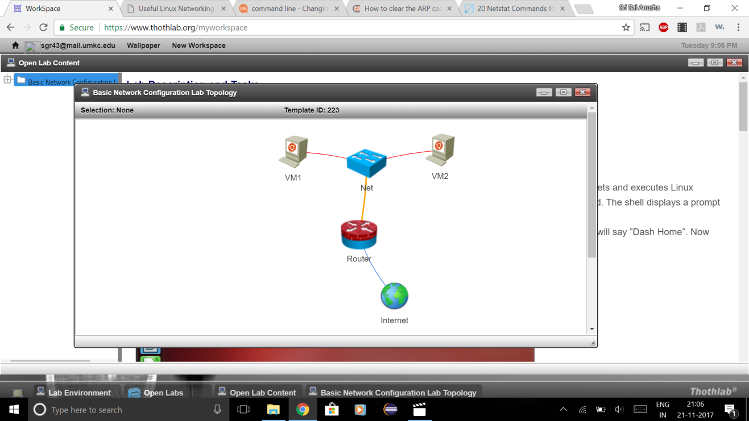

Slide 20
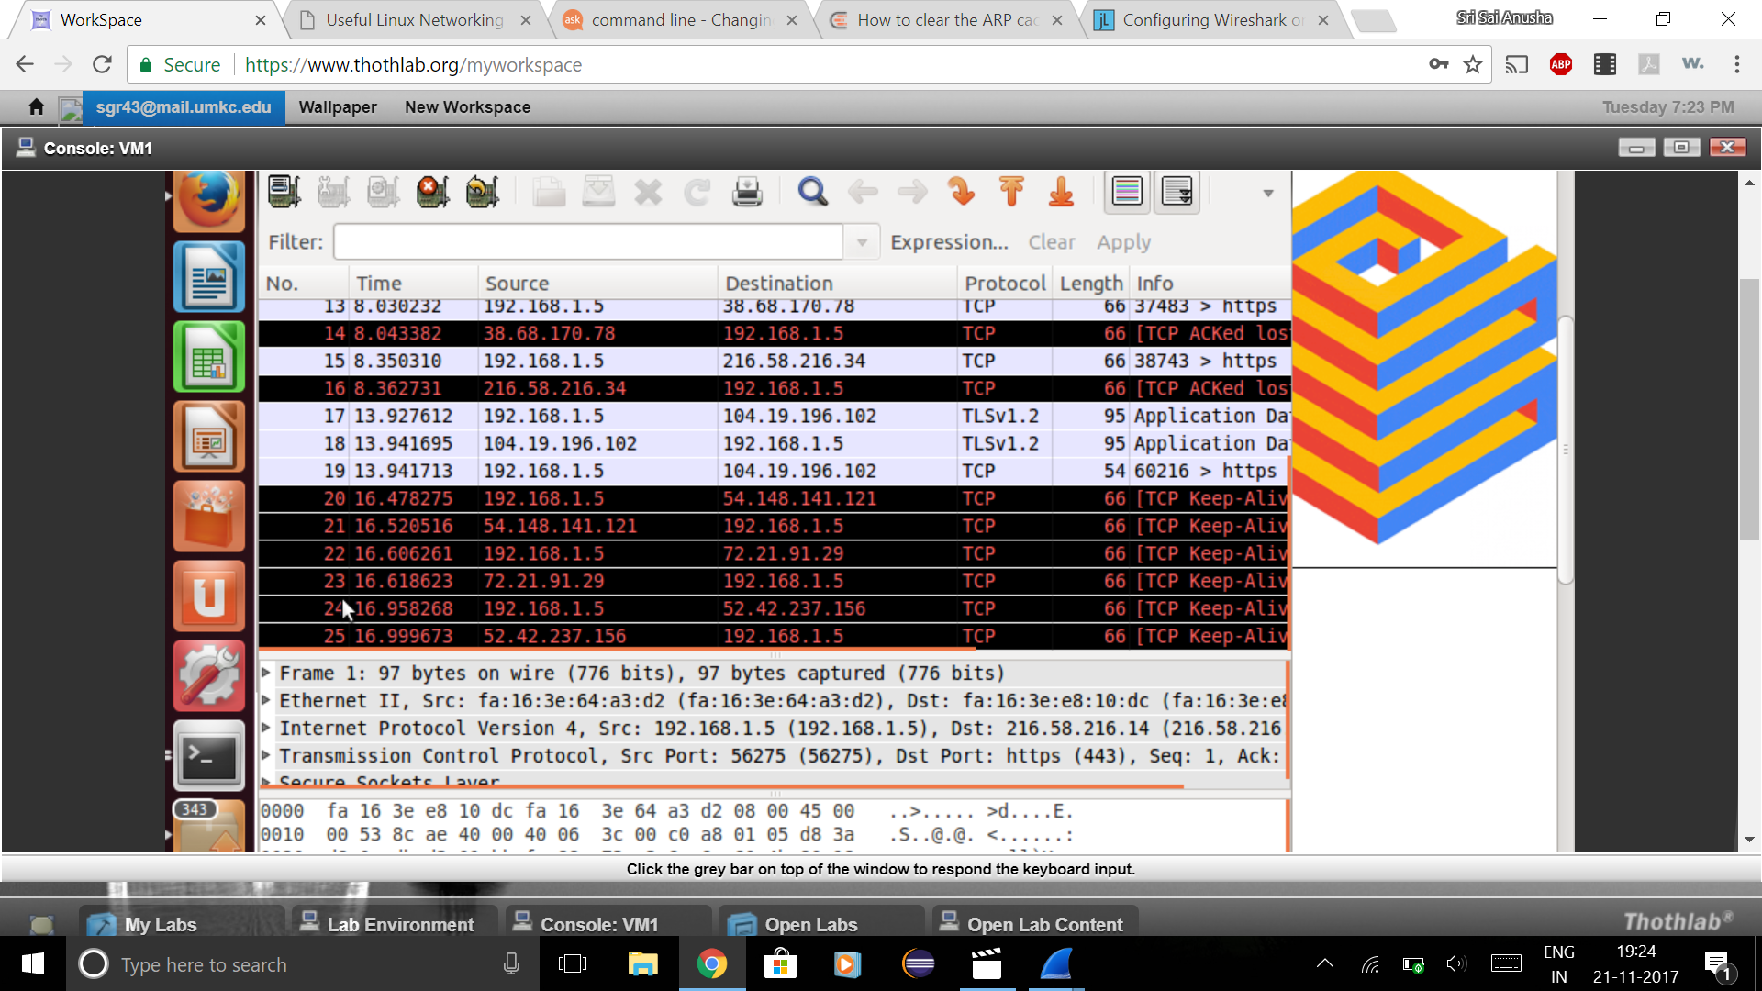

Slide 21
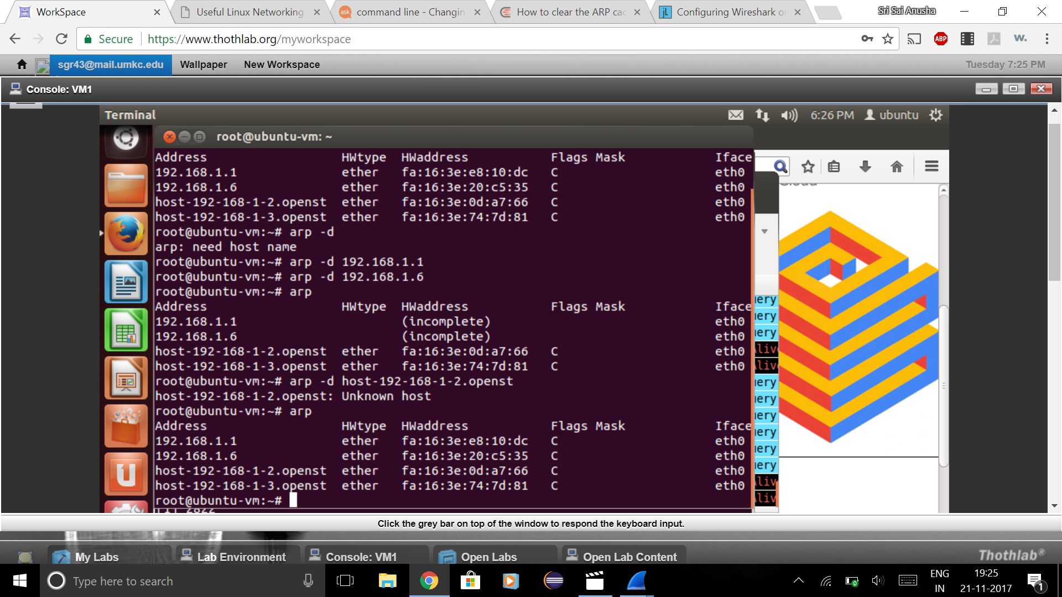

Slide 22
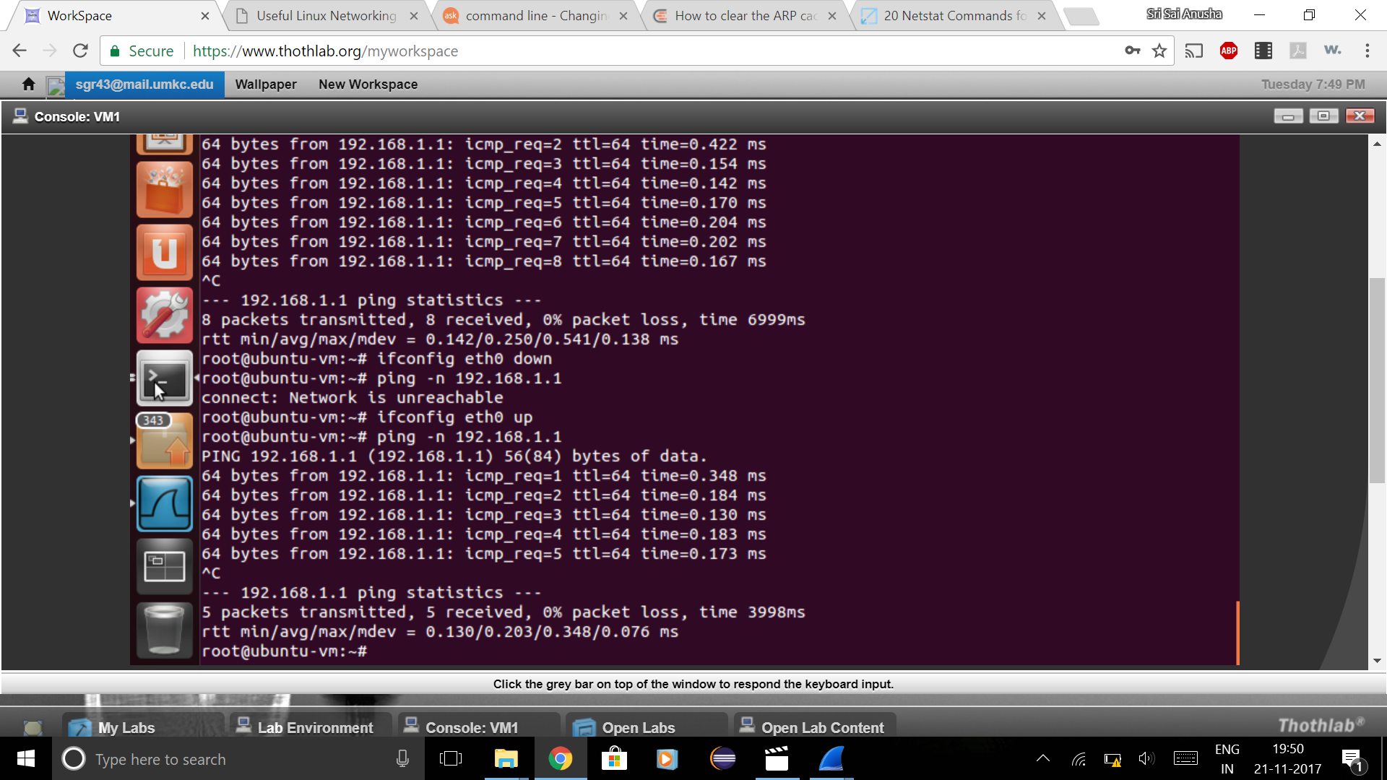

Slide 23
Network Routing Lab
traceroute
Display the route and measure the transit delay (Round Trip Time)

Slide 24
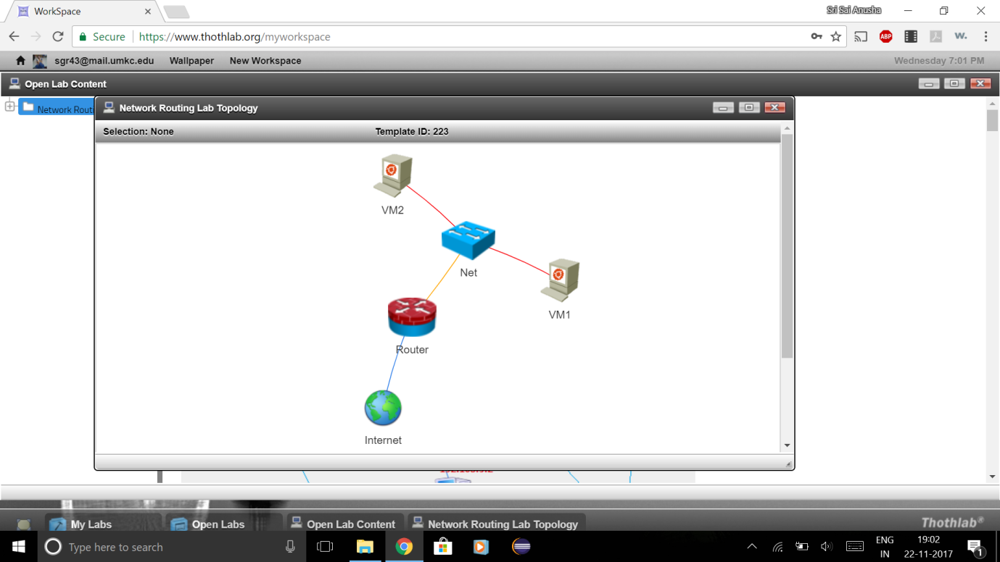

Slide 25
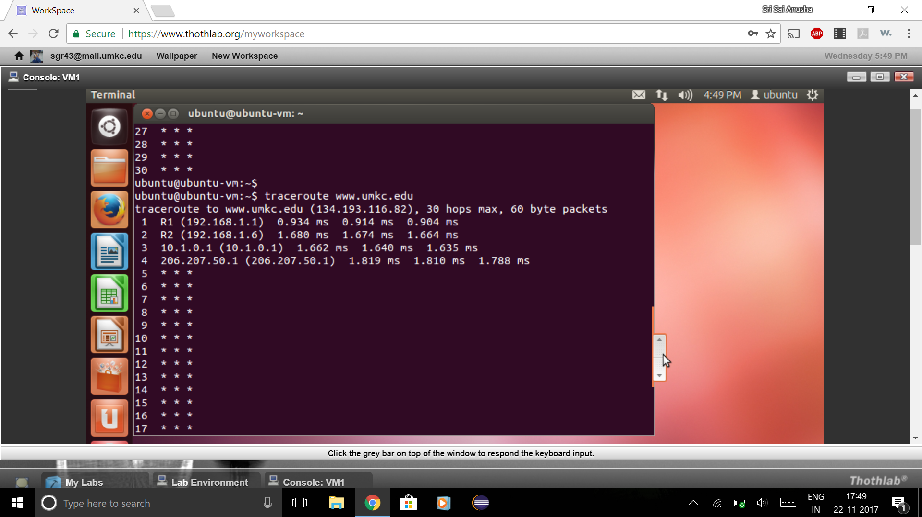

Slide 26
Routing Protocols and NMap
Router communication
Exchange of information
NMap: Discover hosts and services

Slide 27
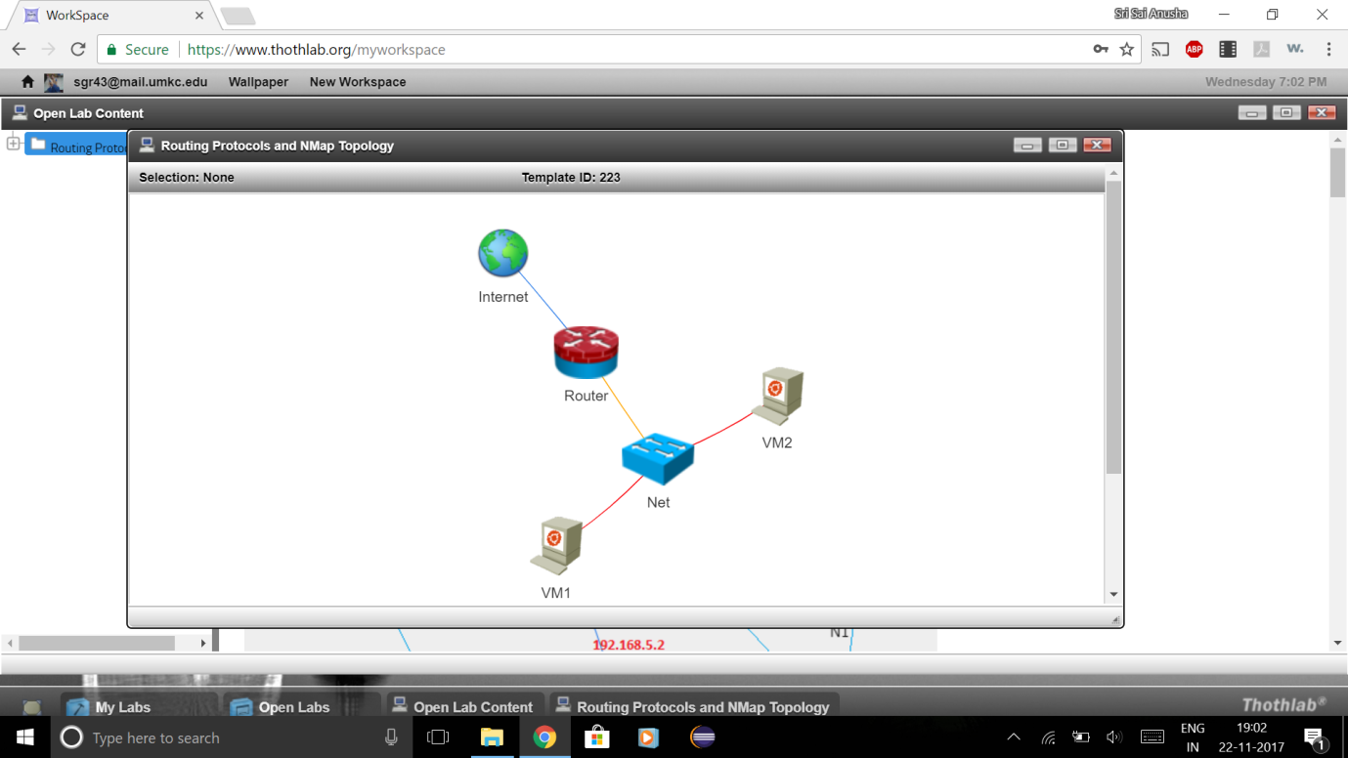

Slide 28
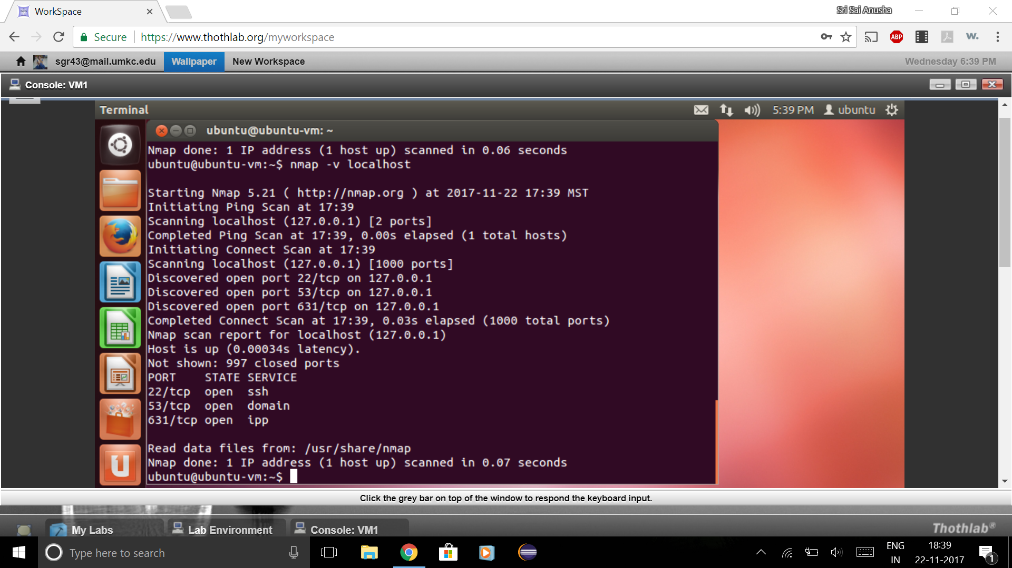

Slide 29
Apache Server Lab
Open source HTTP server for hosting web service

Slide 31
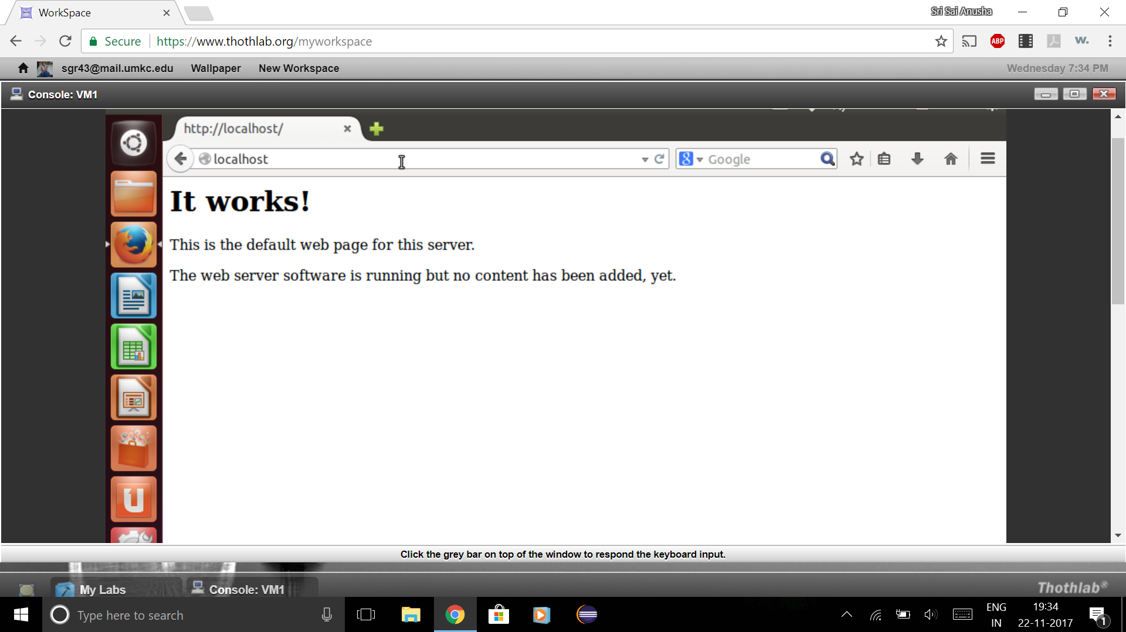

Slide 32
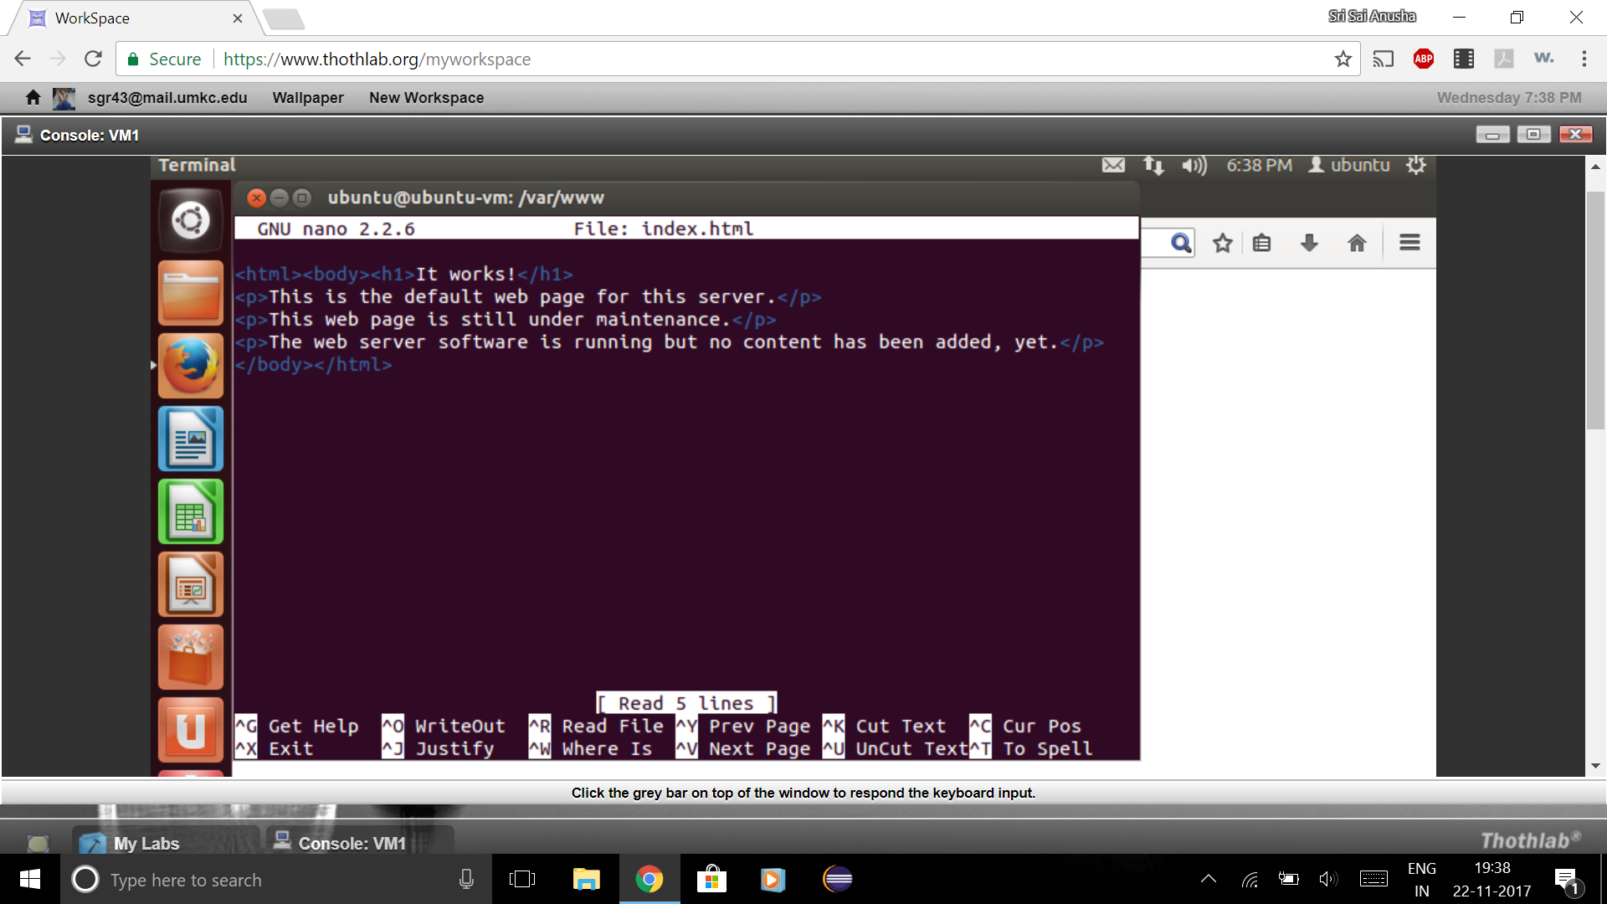

Slide 33
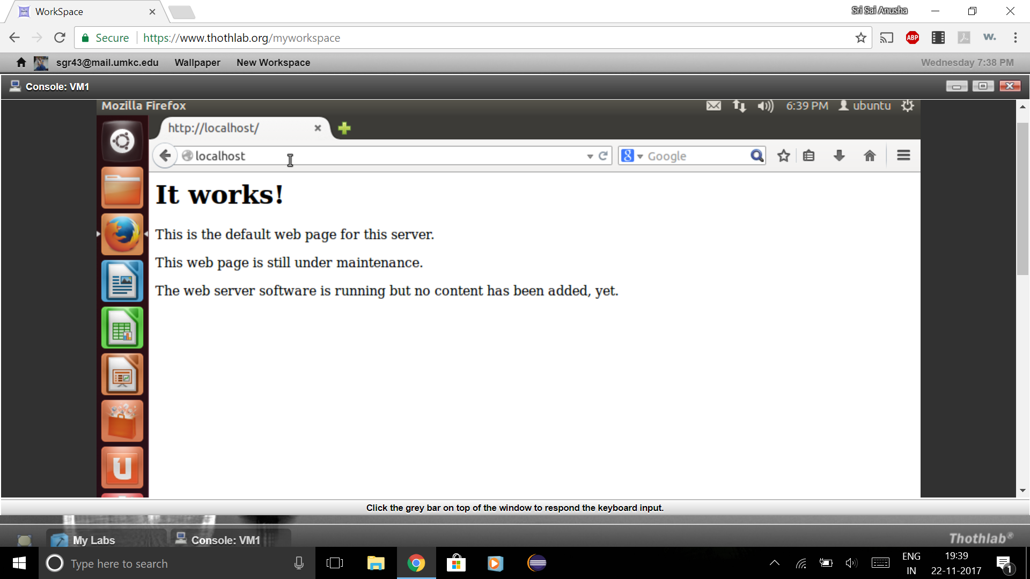

Slide 34
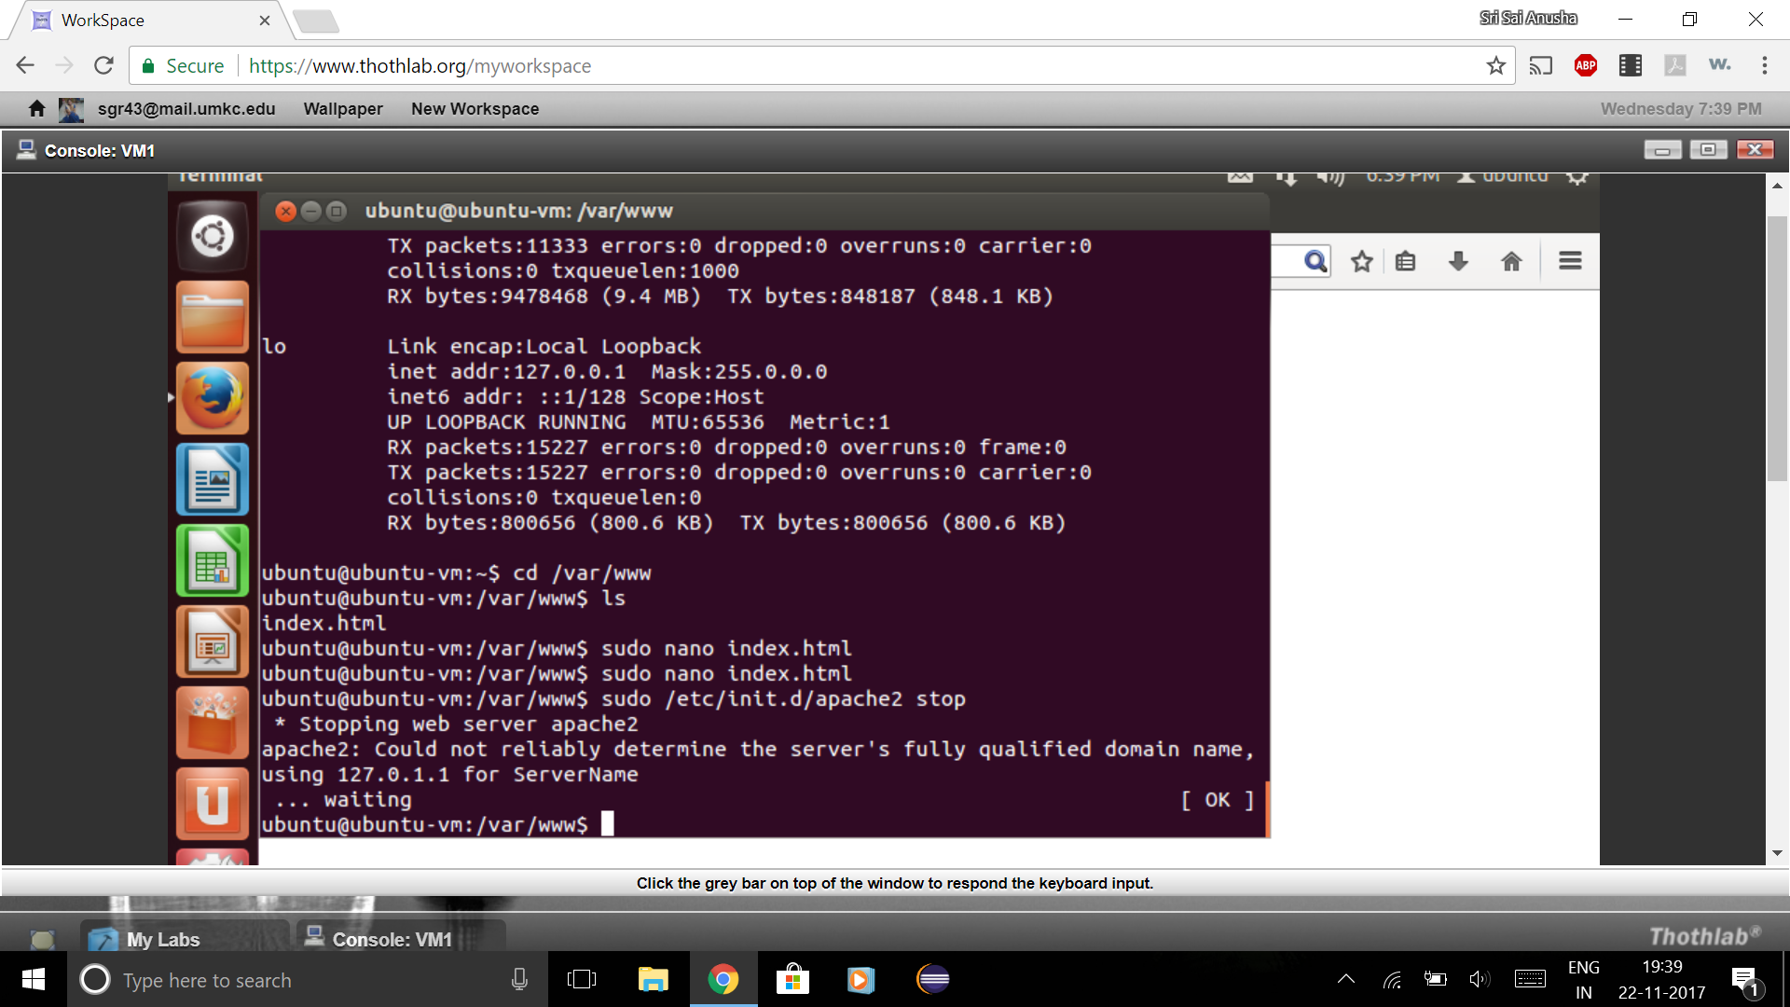

Slide 35
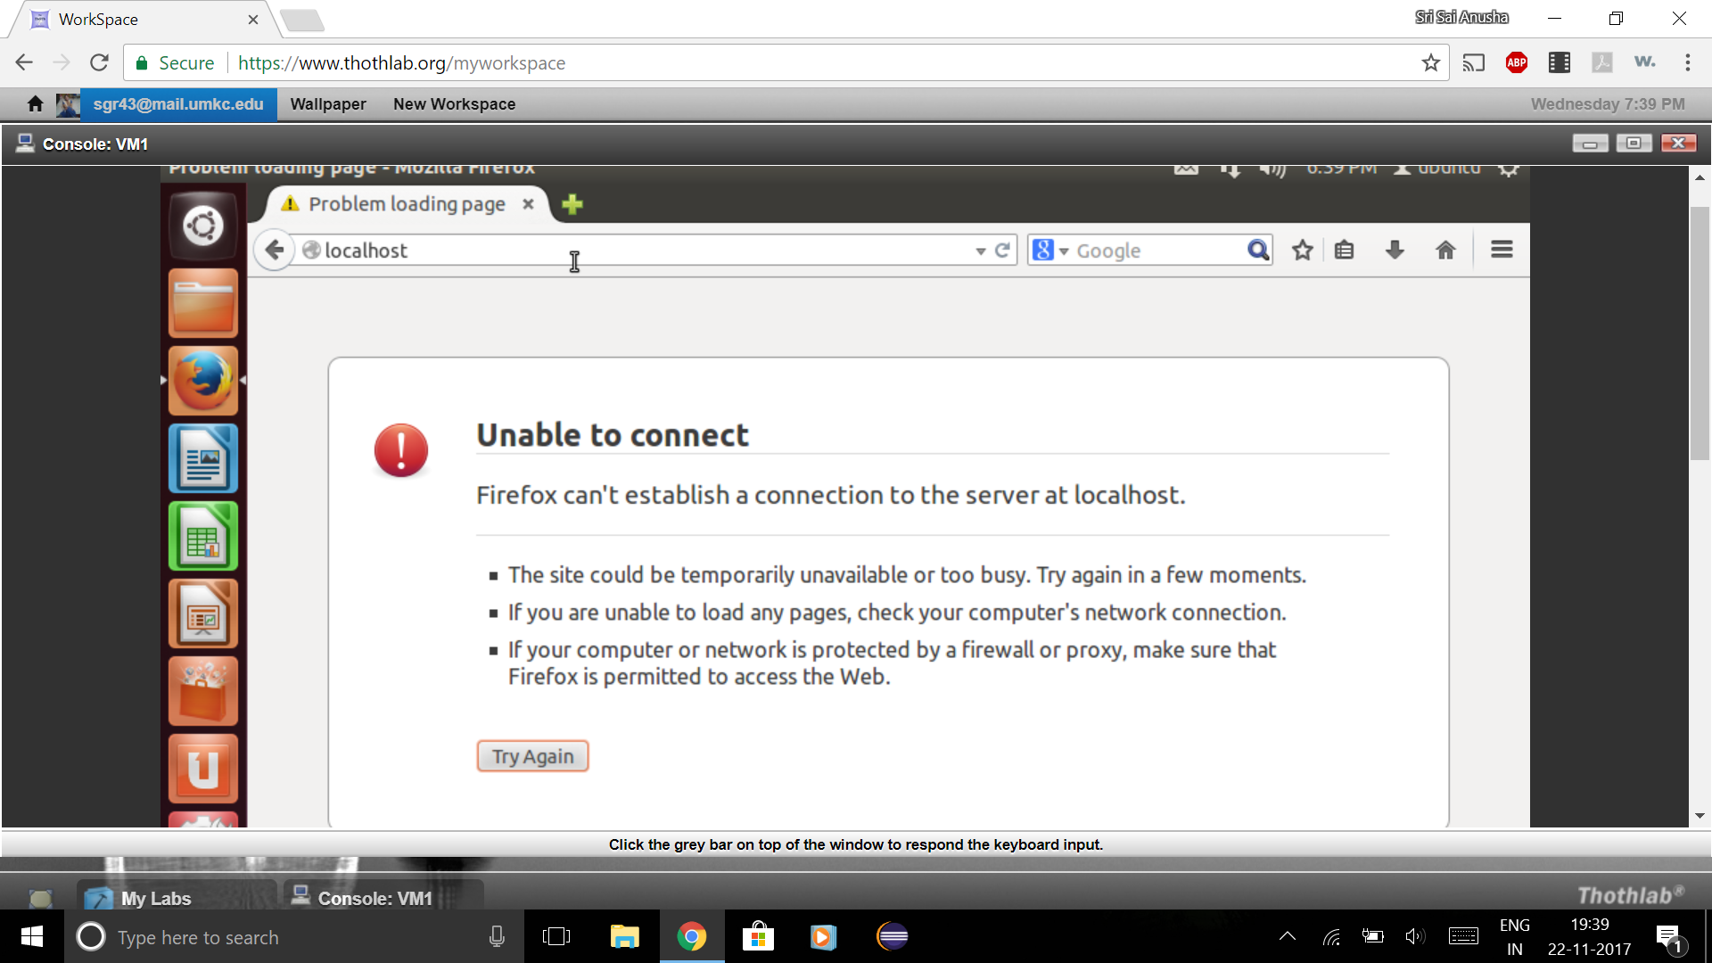

Slide 36
Pros and Cons
Pros
Flexibility
Availability
Adaptability
Maintainability
Expandability
Cons
High delay
Poor performance
Keypad response
Regular rebuilding

Slide 37
References
https://www.thothlab.org/
https://fullcircle.asu.edu/faculty/researcher-entrepreneur-professor-launches-virtual-lab-platform-computing-research-education/
http://www.athenets.com/
https://www.digitalocean.com/community/tutorials/how-to-install-hadoop-in-stand-alone-mode-on-ubuntu-16-04
https://www.digitalocean.com/community/tutorials/how-to-install-cassandra-and-run-a-single-node-cluster-on-ubuntu-14-04

Slide 38
Thank You!!

